Slide 1
A Comparison of Two Scriptures
1
Cornelius and the Angel - Acts 10
and
The Raising of Lazarus - John 11

Slide 2
Cornelius and the Angel – Acts 10 verses 1- 8 verses 23 - 27 verses 44 - 46
2

Slide 3
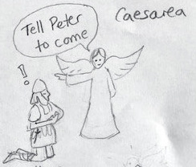
3

Slide 4
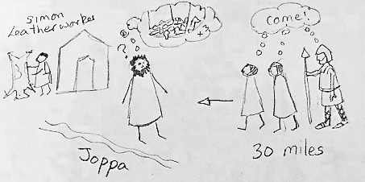

4

Slide 5
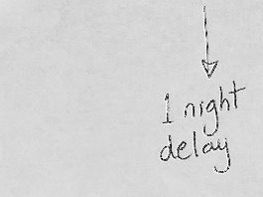
5

Slide 6


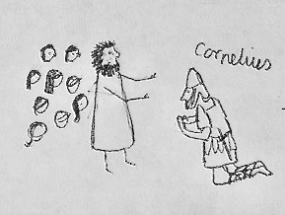
6

Slide 7
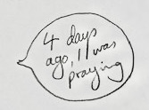
7

Slide 8
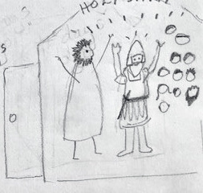
8

Slide 9
9
The Raising of Lazarus - John 11

Slide 10
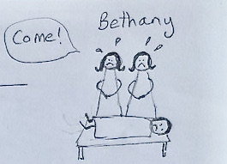
10

Slide 11
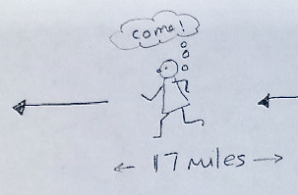
11

Slide 12
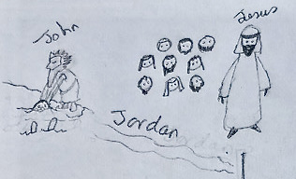
12

Slide 13
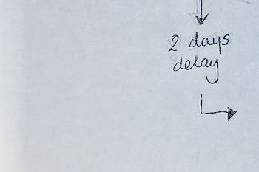
13

Slide 14
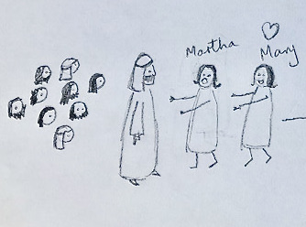
14

Slide 15
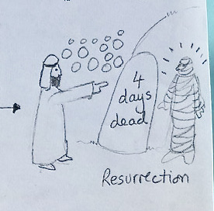
15

Slide 16
16
Compare the two scriptures….

Slide 17
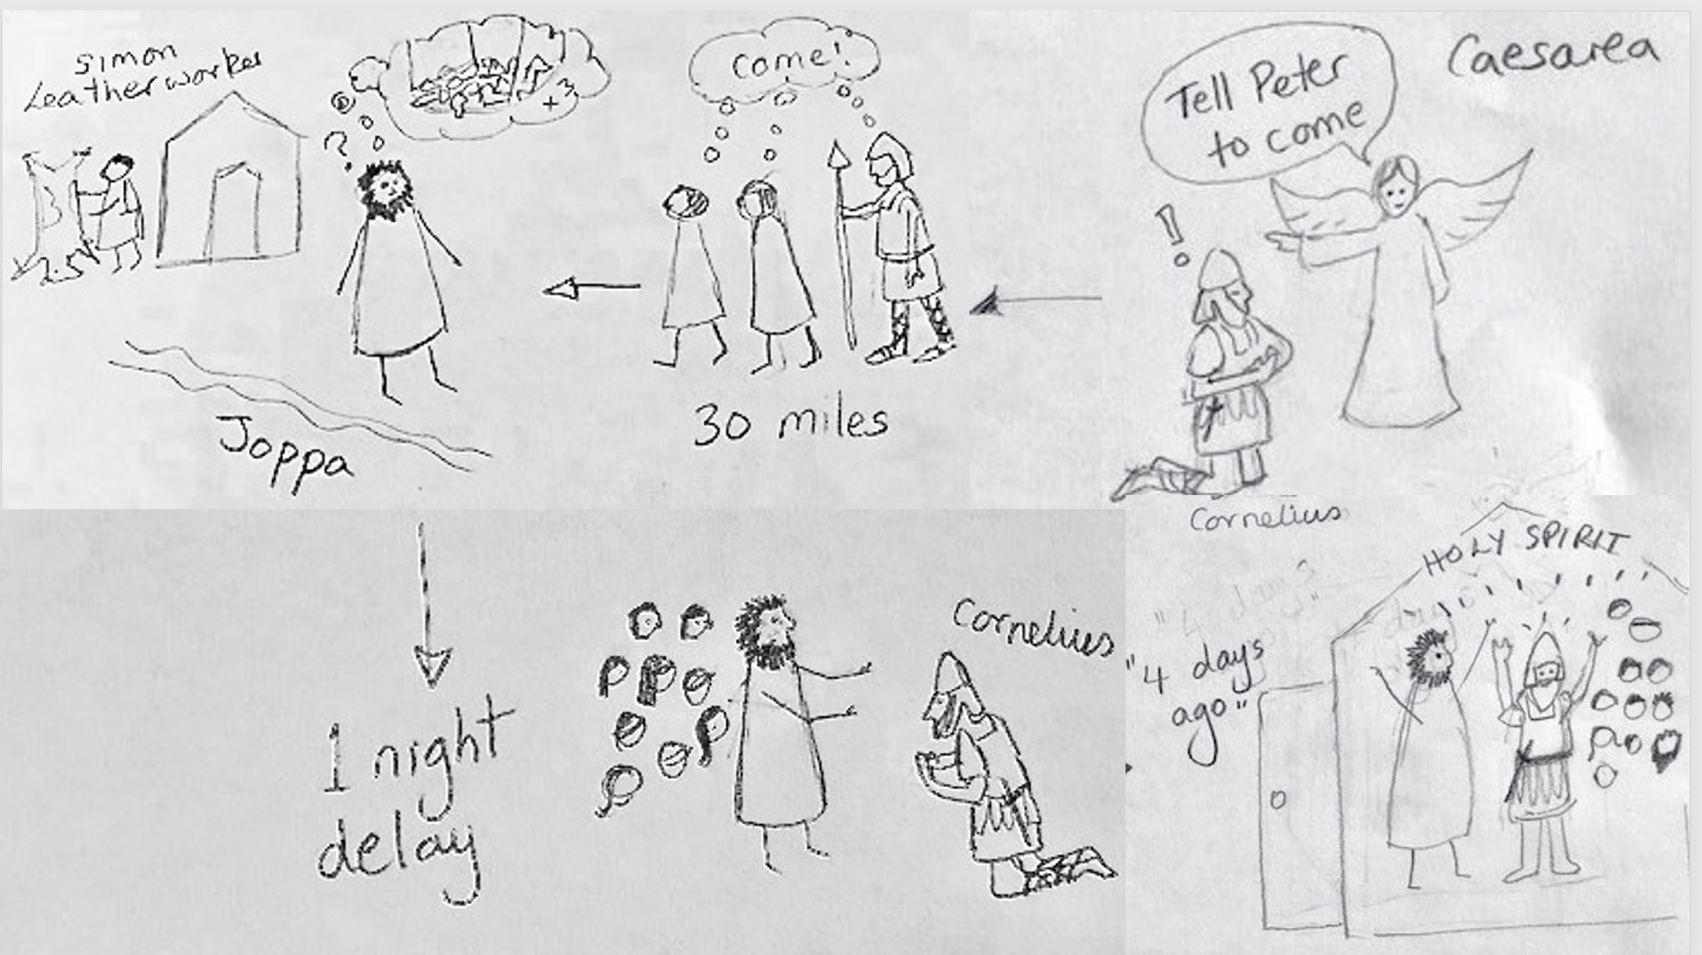
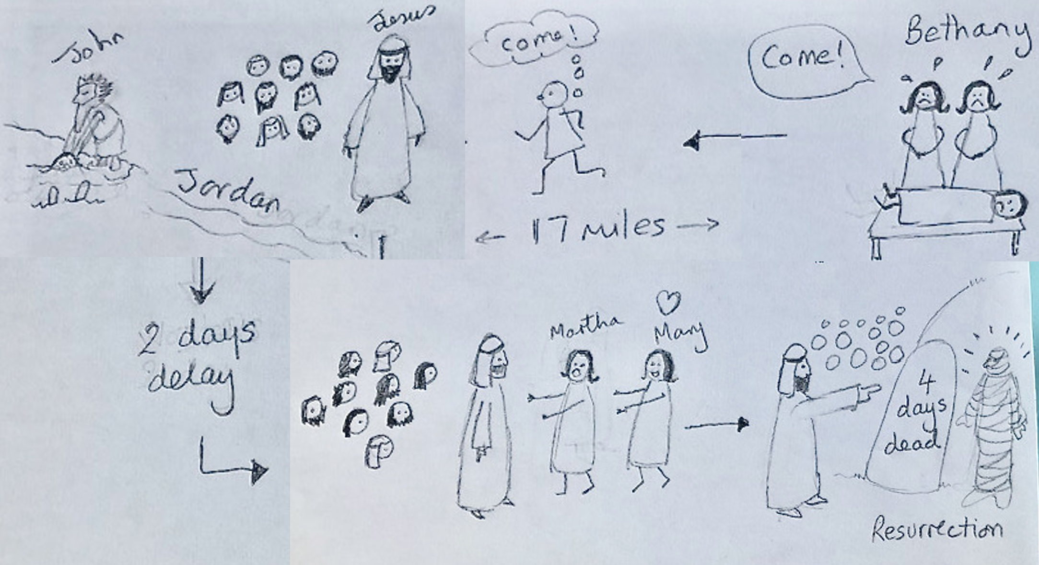
17
Cornelius and the Angel Acts 10
The Raising of Lazarus John 11

